Slide 1
Output
Step 1-Resizing

Slide 2
Some Background
Great pictures and editing are worthless if you can’t get your pictures out for people to see.
There are two forms of output.
Electronic-posting online, emailing, etc.
Printing

Slide 3
Some Background
Output has its own workflow.
Resizing
Sharpened (optional)
Output for specific need
Saving the printable file
For Photoshop output you should stick to the order listed above.

Slide 4
Why Resize?
Typically your camera will capture many more information than you need.
Old cameras or shooting with your camera set on low resolution are the exception.
Web posting and email often has save limits.
Even at 8 megapixels, printing an 8x10 often requires resizing.
If you printing poster size pictures, you may even need to enlarge your image.

Slide 5
Why Resize?
Your camera captures millions of pixels, but doesn’t always capture a resolution that is appropriate for your output.
Cameras often capture images at a resolution of 72ppi.
This sizes the pixels and spaces them so that there are 72 side by side in an inch.
This is most often what computer screens use too.

Slide 6
Why Resize?
If the image was taken with a 5 megapixel camera, the image will be several square feet.
This isn’t a problem on screen because you can zoom in and out endlessly.
When printed, the image won’t fit on to paper and, at 72 ppi, is too low quality to look good.
An image will have the same file size at 300 ppi as it will at 72 ppi.
The pixel count stays the same, the file just changes the number of pixels that are crammed into an inch.

Slide 7
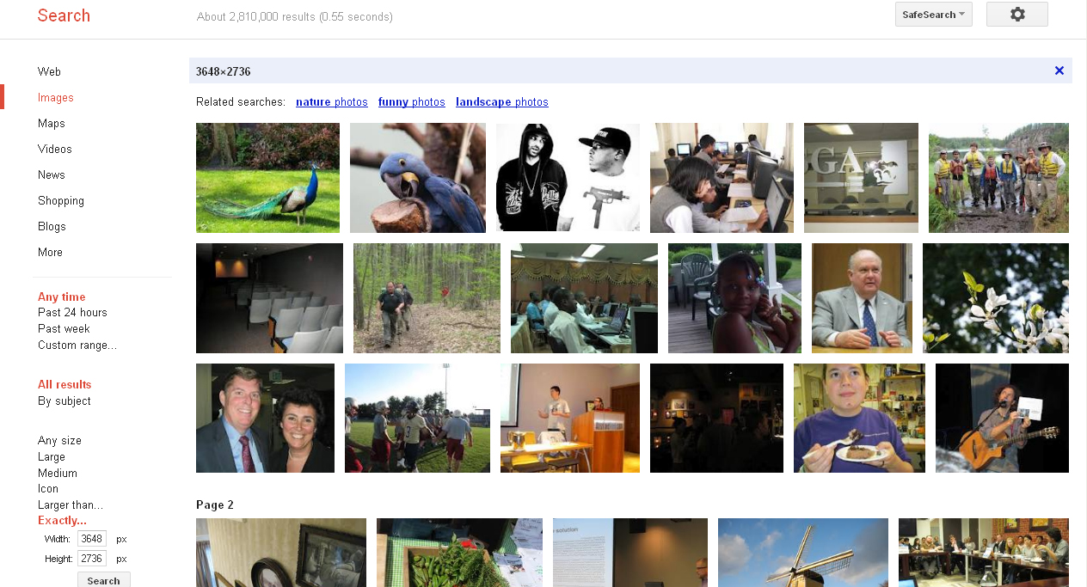
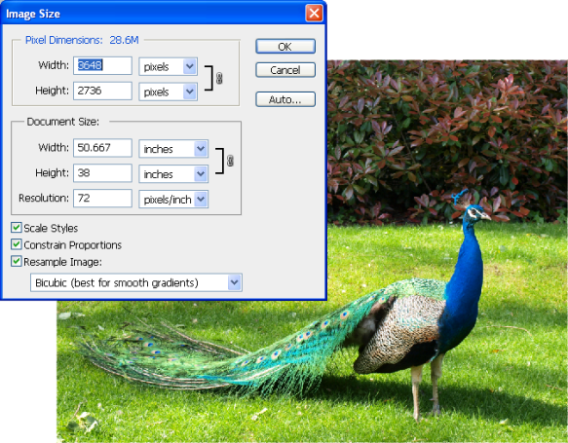
Why Resize?
This # is the
pixel count
An example
A 10 megapixel outputs an image with dimensions of 3648 x 2736 and a resolution of 72 ppi.
Go to google and find an image that is exactly this pixel count & dimension. Save the image and open it in Photoshop.
Go to Image>Image size and make sure that the resolution is 72ppi
This means the pixels are sized and aligned so there are 72 in one inch.
This dialog box tells you that the overall size of the picture would be 72” x 38”.
This is too big to print on most printers, and too low quality.
This is the resolution

Slide 8
Why Resize?
Paper size
Image size… not good!

Slide 9
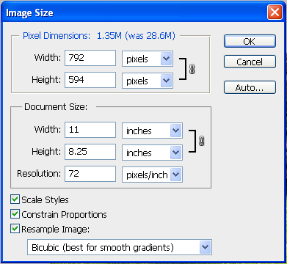
Why Resize?
If we want the image to fit onto a normal sheet of paper, 8.5 x 11, it will need to be adjusted.
Some pixels will need to be thrown away.
In the Image size dialog box, make sure all three boxes at the bottom are checked.
Every third pixel will be discarded.
The amount of data was changed, which is known as resampling.
The image has too low of a resolution now though.
If the image needed to be enlarged, this same method can be used.
Instead of discarding data, Photoshop would add pixels .
Through interpolation it determines what colors pixels to add.

Slide 10
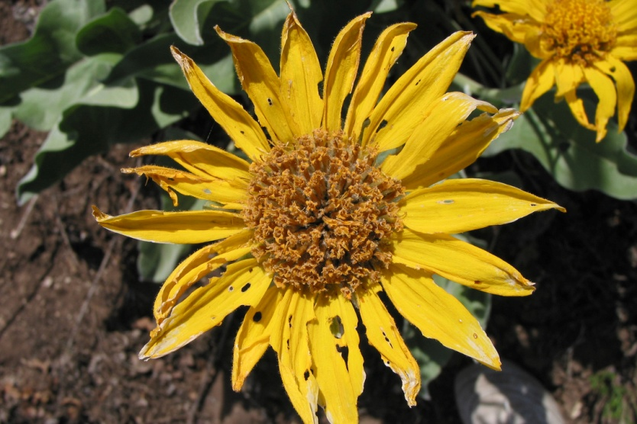
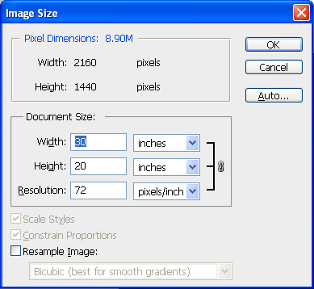
An Example
Let’s experiment-Open the flower file.
Choose Image>Image size.
Take a look around.
The pixel dimensions are listed at the top.
The document size is listed just below it.
This shows resolution in ppi.
The output dimensions are also shown.
There are three options to check at the bottom.
Uncheck Resample image
Now the pixel values are not editable.

Slide 11
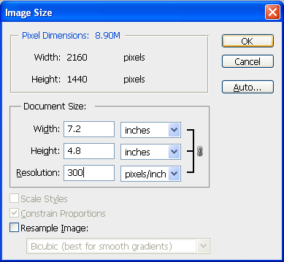
An Example
Notice that width, height, and resolution are now linked.
This means that if you change one, the others change accordingly.
This preserves the aspect ratio, keeping things from being stretched or squished.
With Resample unchecked, you are not allowing Photoshop to add or remove pixels.
Your image can change size, but you only working with the pixels that your camera gave you.
Basically your pulling pixels apart or squishing them together as if you image was on a piece of rubber.

Slide 12
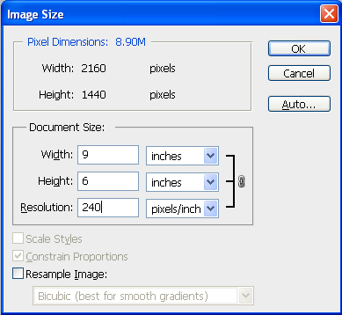
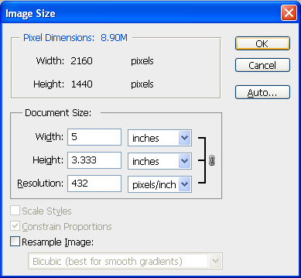
An Example
Now enter 240 for resolution.
You’ll see the image size becomes 9x6.
Now try changing the print size to 3x5
The resolution now turns to 432.
This resolution is too much for a printer, but there is too much data to print it at 3x5 and 240 ppi.
We have to use resample to get our image to 240 & 3x5.

Slide 13
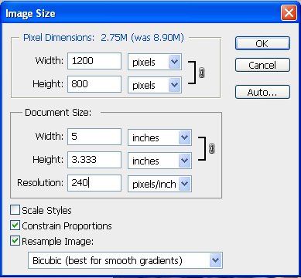
An Example
Check the resample box.
The width and height in the pixel dimensions box are editable again.
Resolution is no longer linked to height and width.
Change the resolution to 24 (height and width should still be set at 5x3.33.
This cut the pixel dimensions and file size significantly.
The resample method changed too.

Slide 14
An Example
A few other notes about the Image size dialog.
Do I need to worry about printing a file with a res higher than is printable?
Not at all. The printer will be fine.
The file size will take up more space when saved though.
What’s the deal with Scale Styles?
When checked, this will scale embossing, drop shadows, etc.

Slide 15
When should I Resample?
Basically anytime your image has too few or too many pixels for what you need.
Downsampling (reducing the size)
For the web (email, sharing sites, etc.) you will almost certainly need to downsample.
If it’s going to be professionally printed and you have more pixels than needed.
If it will be used for video it has to be downsampled.
If your printing yourself but the image is too big.

Slide 16
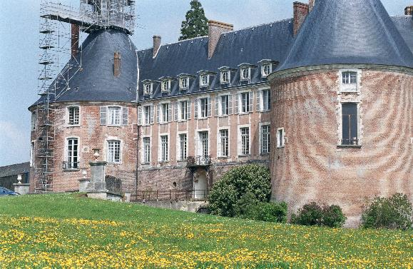
When should I Resample?
Upsampling (enlarging the size)
Do as little as possible.
Aliasing artifacts, loss of sharpness can occur
When you do it, make one edit count.
There is software specifically made to upsample if you intend to do a lot of it.
http://www.svi.nl/AntiAliasing

Slide 17
Let’s Review
There are two forms of output: Electronic & Print.
The output workflow is resizing, sharpen, output, & save.
Cameras seldom capture just the right amount of data.
Pixels can be used for any resolution, 72, 300, etc.
Resampling is the act of adding (upsampling, done through interpolation) and subtracting (downsampling).

